Slide 1


LabNexus: Unified Computer Resources Control
CMR COLLEGE OF ENGINEERING & TECHNOLOGY
(Autonomous)
Kandlakoya, Medchal, HYDERABAD
CENTRE FOR ENGINEERING EDUCATION RESEARCH
REVIEW-III
SOCIAL INNOVATION AND ENTREPRENEURSHIP (A500507)
III SEMESTER A.Y 2026-27
Student Team Details
1. Abhigyan Tiwari – 25H51A67D0
2. K.Bhargavi – 25H51A67F7
3. N.Chandrika – 25H51A67H2
4. B.Ashwitha – 25H51A6716
5. K. Sri Vardhan – 25H51A6717
Faculty Mentors
1. Mrs.R.Sathiyakala Asst. Professor ECE/CEER
2. Dr.B. Venkateshwar Rao Asst.Professor ECE/CEER
3. Mr.K.P.Senthil, Asst.Professor CSM/CEER
LabNexus CMR College of Engineering & Technology

Slide 2

CONTENT
Problem Statement
Existing Solutions
Proposed Solution
Components required
Block Diagram
Flow Chart
Working Principle of all components used/Software modules
Working of Business Model
Results and Discussions
Advantages and Drawbacks
References

Slide 3

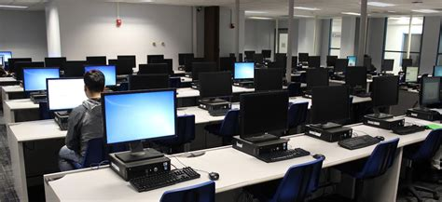
PROBLEM STATEMENT
In environments such as computer labs, computer libraries, and educational institutions, administrators face significant challenges in managing multiple computers efficiently.
Without a centralized system, tasks such as scheduling usage times, enforcing automatic shutdowns, and coordinating holidays or breaks become time‑consuming and resource‑intensive.
This lack of control also leads to unnecessary power wastage, increasing operational costs and reducing sustainability.
LabNexus CMR College of Engineering & Technology

Slide 4

EXISTING SOLUTIONS
1. MyPC
  Focused on recurring scheduling with admin templates.
  Allows bulk generation of schedules for future date ranges.
  Ideal for labs where students book slots repeatedly (e.g., weekly lab sessions).
LabNexus CMR College of Engineering & Technology

Slide 5

EXISTING SOLUTIONS
2. QReserve
  Resource-centric reservation system.
  Provides conflict prevention and approval-based scheduling.
  Works well for shared workstations in labs or coworking spaces.
LabNexus CMR College of Engineering & Technology

Slide 6

EXISTING SOLUTIONS
3. GoGuardian Teacher
  Designed for real-time classroom and lab supervision.
  Features live screen monitoring, blocking, and instructional control.
  Strong fit for K‑12 labs where teachers need oversight.
LabNexus CMR College of Engineering & Technology

Slide 7
PROPOSED SOLUTION
Centralized Control: One admin console to manage every lab PC — schedules, live status, and overrides.
Timetable & Holiday Control: Syncs with the college timetable. Planned holidays auto-cancel slots. A sudden holiday shuts the lab in one click.
Bulk Scheduling: Generate a weekly timetable once and apply it across selected labs in a single action.
Attendance-based Power: Class booked for 64, only 40 present → only 40 PCs wake or unlock. The other 24 stay off.
Admin Grants More Access: Need extra machines? Admin gives access to more computers — one PC or several — for a set time, without opening the whole lab.
Analytics Dashboard: Usage, idle time, extra access grants, and energy saved — including PCs that never turned on.
LabNexus CMR College of Engineering & Technology

Slide 8
COMPONENTS REQUIRED
Software / Technologies
Admin Console (Frontend): Same Express app serves the dashboard: single-page HTML/CSS/JS UI, live seat grid
Backend API: Node.js + Express (REST API + Server-Sent Events for live updates)
Database: JSON file persistence (auto-saved state; no DB server needed in v1)
Lab Agent: Node.js agent on each PC (outbound polling every 3 s; executes lock / unlock / sleep / wake / message / reboot)
Authentication: Session-cookie admin login (HttpOnly, 12 h) + per-PC agent tokens (X-PC-Token header)
Scheduling: Desired-state engine: LOCKED / UNLOCKED / SLEEPING with time-boxed grants (1-1440 min), auto-relock on expiry
Analytics: Live seat grid + audit log (every action time-stamped; persisted across restarts)
OS: Windows 10/11 verified end-to-end (agent is cross-platform Node.js: Windows / Linux / macOS)
LabNexus CMR College of Engineering & Technology

Slide 9
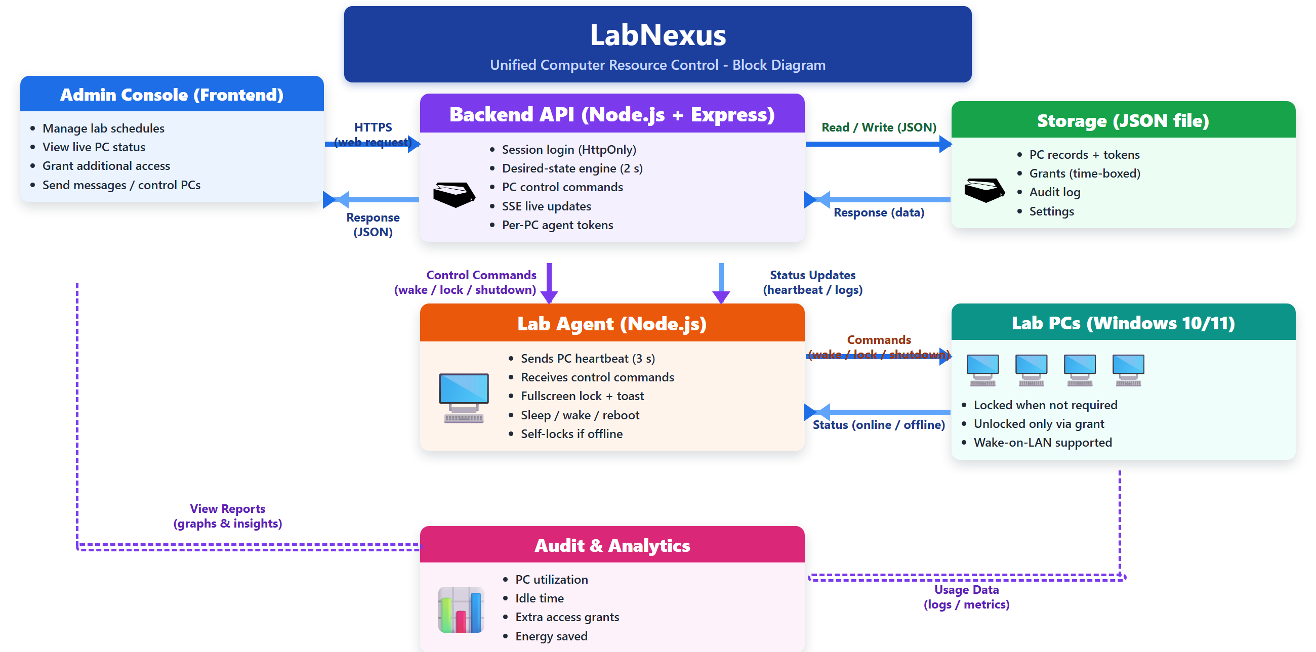
BLOCK DIAGRAM
LabNexus CMR College of Engineering & Technology

Slide 10
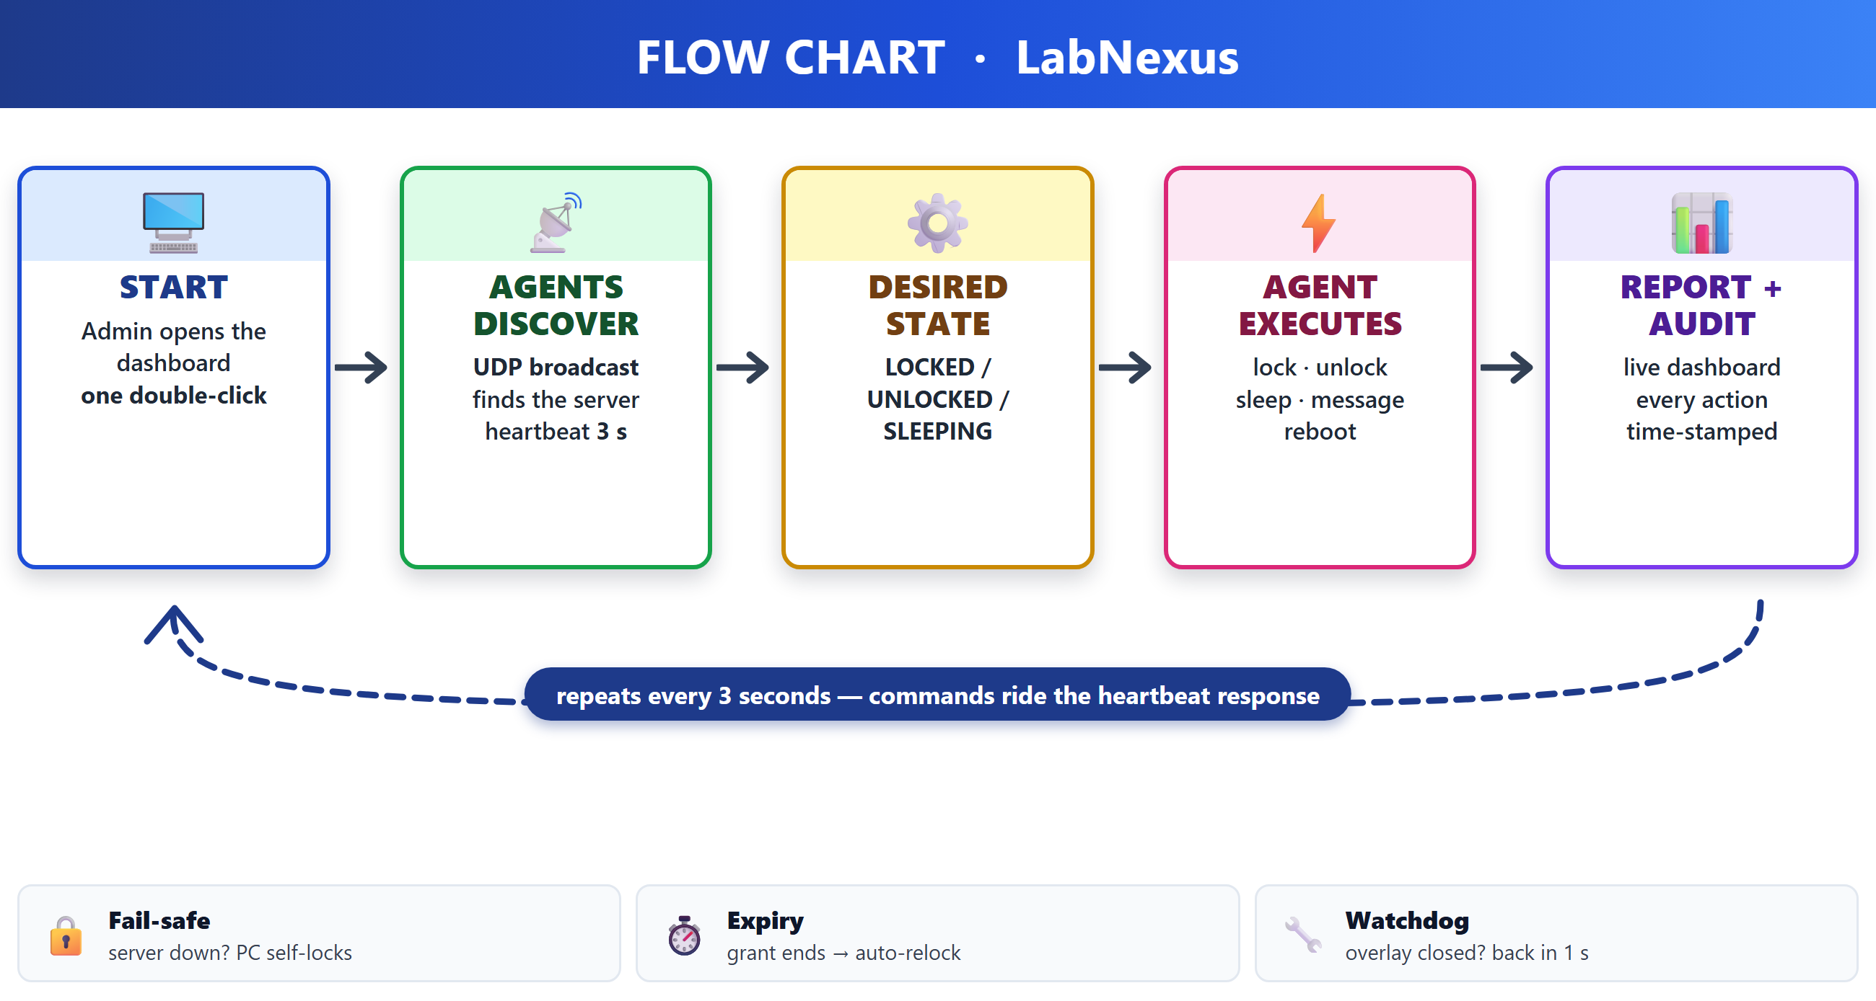
FLOW CHART
LabNexus CMR College of Engineering & Technology

Slide 11
WORKING PRINCIPLE OF ALL COMPONENTS USED/SOFTWARE MODULES
Dashboard: One web page shows every lab PC as a live card — free, locked or sleeping. The admin can grant extra time to a PC, message it, or sleep / reboot it; updates appear instantly.
Server (Node.js + Express): Keeps PCs, tokens, the weekly schedule and an audit log in one JSON file. A tick engine matches every PC to the timetable, and Wake-on-LAN packets wake the needed PCs before class.
Login & tokens: The admin logs in with a session cookie; each agent carries its own secret token (X-PC-Token), and a wrong token is rejected.
Lab agent (on every PC): Calls home every 3 s and runs lock / unlock / sleep / reboot / message. A PC without a grant is covered by a fullscreen lock — if the server goes down, the PC locks itself instead of staying open.
Timetable & analytics: A timetable photo is read into the weekly schedule by the Gemini vision API; holidays cancel the slots. Every action is time-stamped, and the dashboard reports usage, idle time and power saved.
LabNexus CMR College of Engineering & Technology

Slide 12
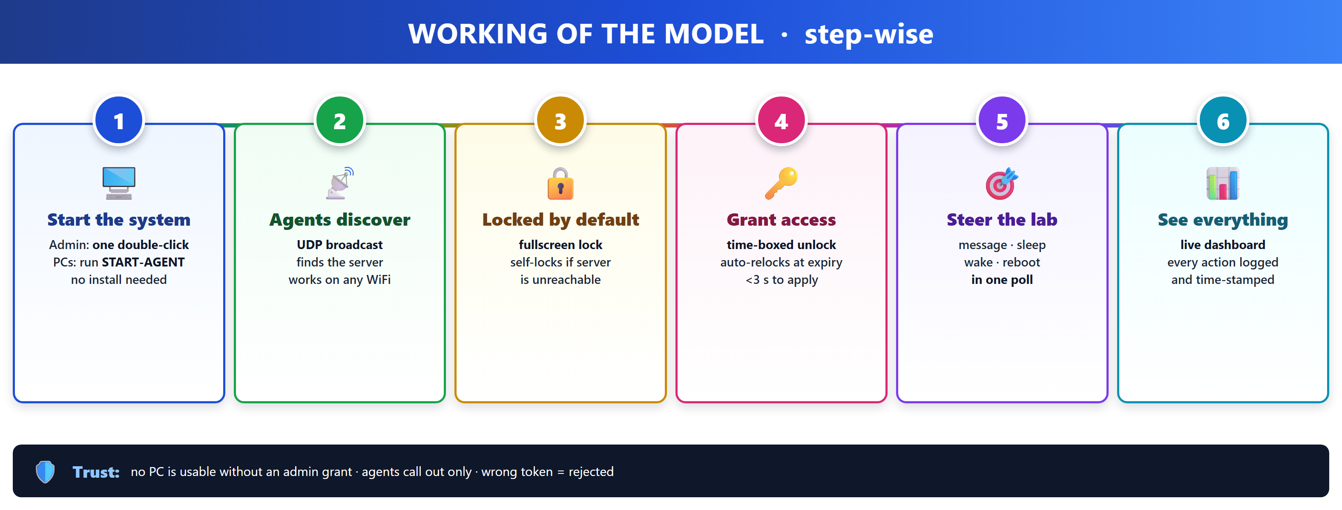
WORKING OF THE BUSINESS MODEL
LabNexus CMR College of Engineering & Technology

Slide 13
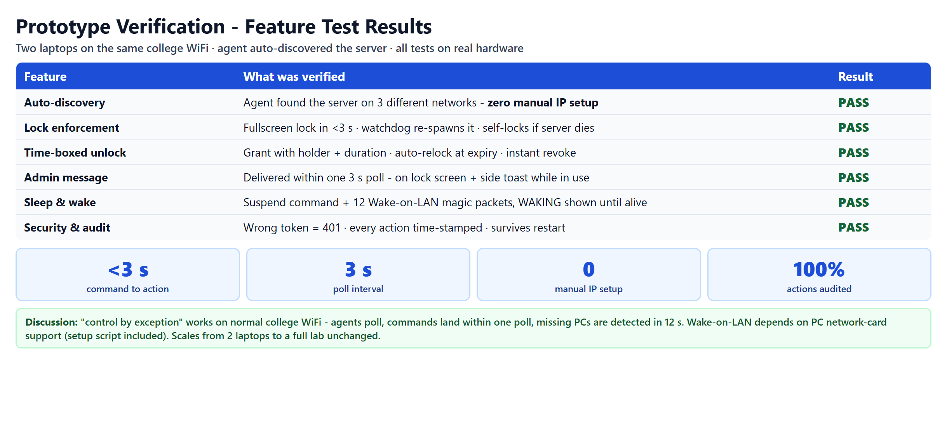
RESULTS AND DISCUSSIONS
LabNexus CMR College of Engineering & Technology

Slide 14
ADVANTAGES & DISADVANTAGES
Advantages:
Centralized management of laboratory PCs
Automatic scheduling
Holiday-based schedule control
Attendance-based PC allocation
Reduced unnecessary power usage
Real-time PC monitoring
Temporary additional access
Usage and energy-saving analytics
Reduces manual administrative work
Disadvantages
Requires installation of a Lab Agent on each PC
Requires reliable network connectivity
Initial setup and configuration may require time
Requires appropriate permissions for PC shutdown/log-off
Security of admin access must be maintained
Actual energy savings depend on laboratory usage patterns
LabNexus CMR College of Engineering & Technology

Slide 15
REFERENCES
J. Wu and X. Guo, "Online booking system design and experimental realization," 2011 International Conference on Electrical and Control Engineering, Yichang, China, 2011, pp. 3556-3560, doi: 10.1109/ICECENG.2011.6057629.
Q. Mai and Y. Chen, "Design and Implementation of Lab Reservation System Based on Applet," 2022 4th International Conference on Artificial Intelligence and Advanced Manufacturing (AIAM), Hamburg, Germany, 2022, pp. 108-113, doi: 10.1109/AIAM57466.2022.00028.
R. Tao, W. Liang, G. Liu and Z. Zhihong, "The Kernel of Lab Intelligent Management System in University," 2014 Enterprise Systems Conference, Shanghai, China, 2014, pp. 336-339, doi: 10.1109/ES.2014.69.
LabNexus CMR College of Engineering & Technology

Slide 16


